Slide 1
C4: Prompt Engineering

Slide 2
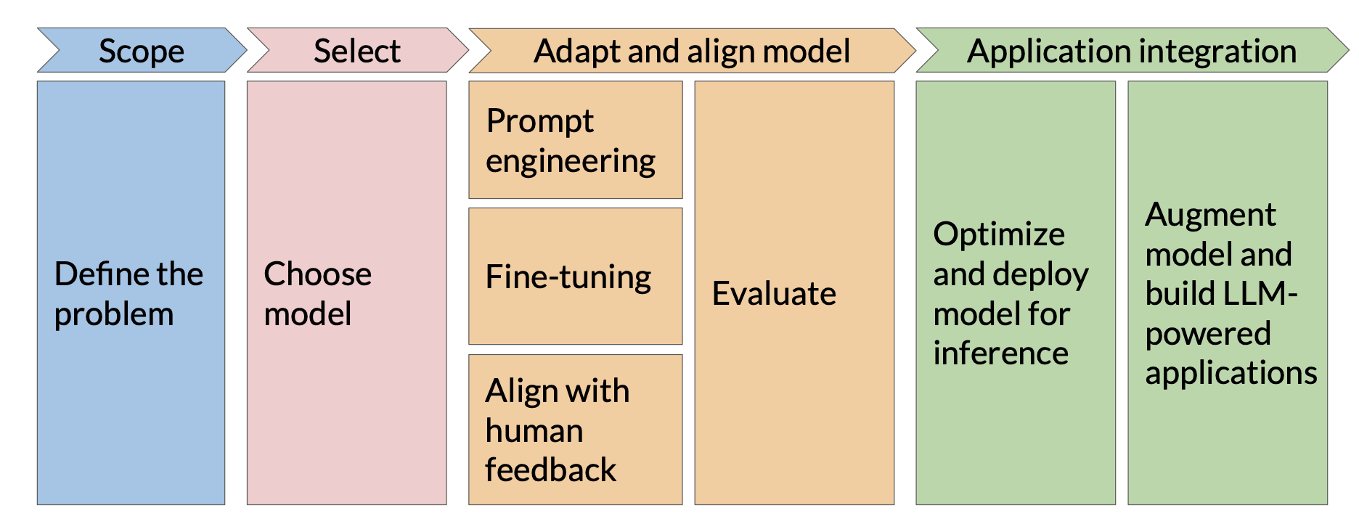
Generative ai development lifecycle

Slide 3

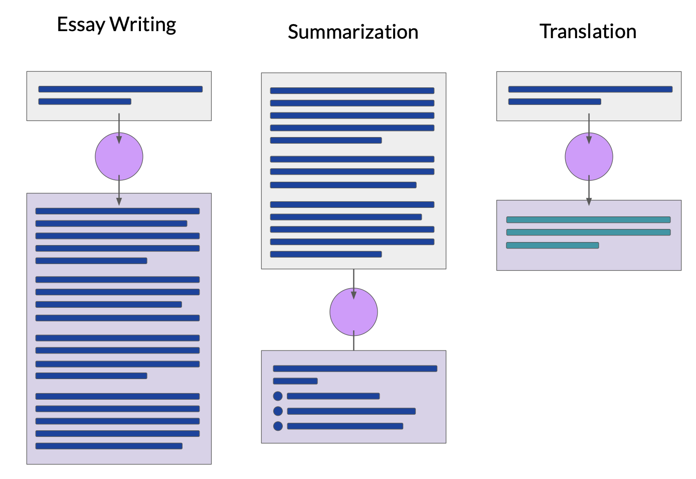
Scope
Input
Output
Encoder?
Decoder? Encoder-Decoder?

Slide 4
Generative ai development lifecycle

Slide 5
Choose model
Understanding the Purpose
• Use Case: Chatbot, code generation, summarization, reasoning, domain-specific applications.
• Commercial vs. Research: Open-source vs. proprietary models.
Model Capabilities & Performance
• Accuracy & Reasoning: Compare benchmark scores (MMLU, HellaSwag, GSM8K).
• Multimodality: Support for text, images, audio, video.
• Multilingual Support: If working with multiple languages.
Cost Considerations
• Open-source vs. Proprietary: Free models (Llama, Mistral, Falcon) vs. paid APIs (GPT-4, Claude, Gemini).
• Inference Cost: Running vs. API call costs.
• Fine-tuning & Hosting Costs: Training requires significant resources.
Compute & Resource Constraints
• Model Size: Small (7B) vs. Large (175B+) models and their trade-offs.

Slide 6
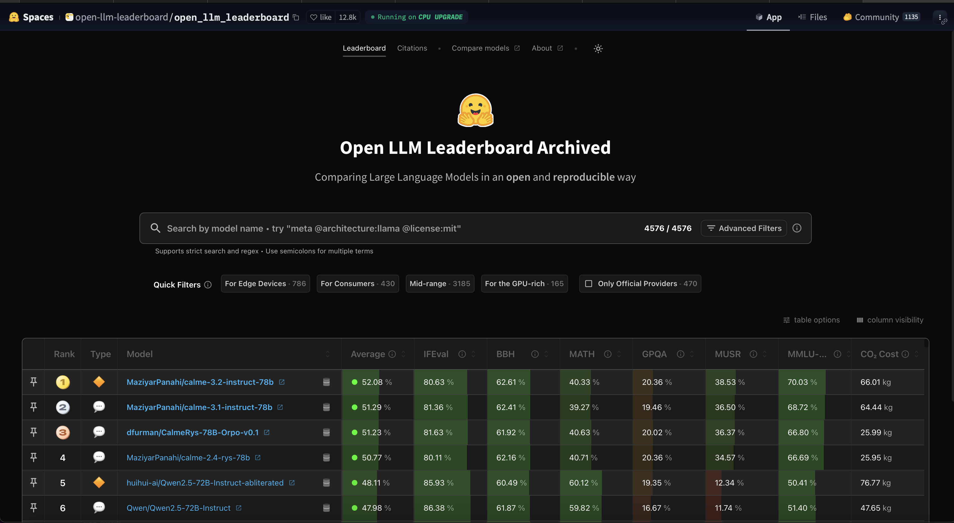
Choose model

Slide 7
Generative ai development lifecycle

Slide 8
Prompt engineering

Slide 9
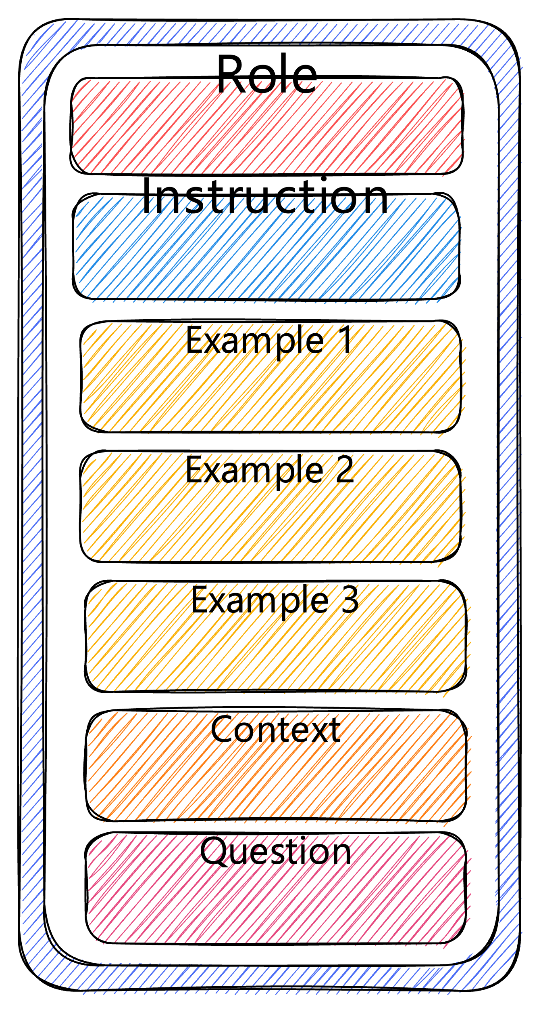
Prompt engineering
A prompt in GenAI models is the textual input users provide to steer the model’s response.
It can range from basic questions to detailed instructions or elaborate descriptions.
In image generation models like DALL·E 3, prompts are typically rich in detail, whereas in LLMs like GPT-4 or Gemini, they can span from straightforward queries to intricate problem-solving tasks.
Prompts typically include instructions, questions, input data, and examples.
However, to obtain a desired response from an AI model, a prompt must at least contain instructions or a question, while other elements are optional.

Slide 10
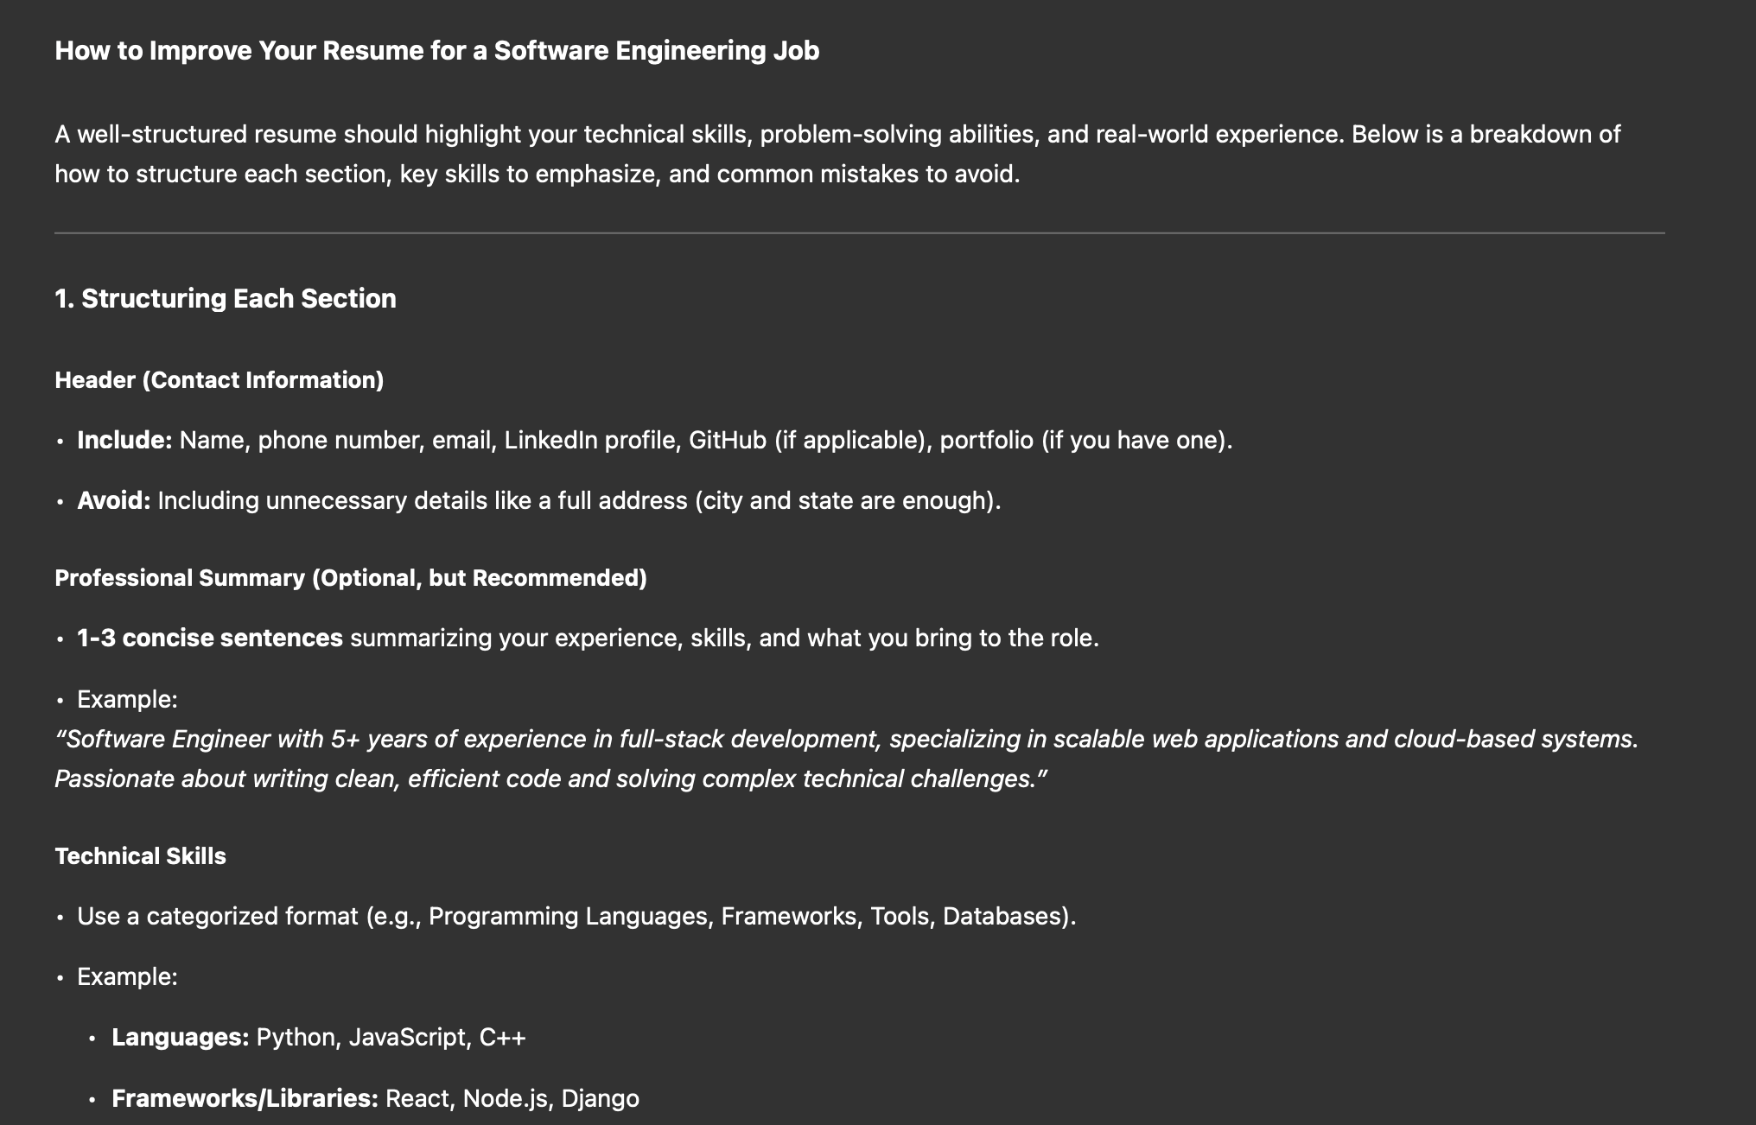
Prompt engineering
Instructions + Question
“How can I improve my resume for a software engineering job?
Provide tips on structuring each section, suggest key skills to highlight, and mention common mistakes to avoid.”

Slide 11
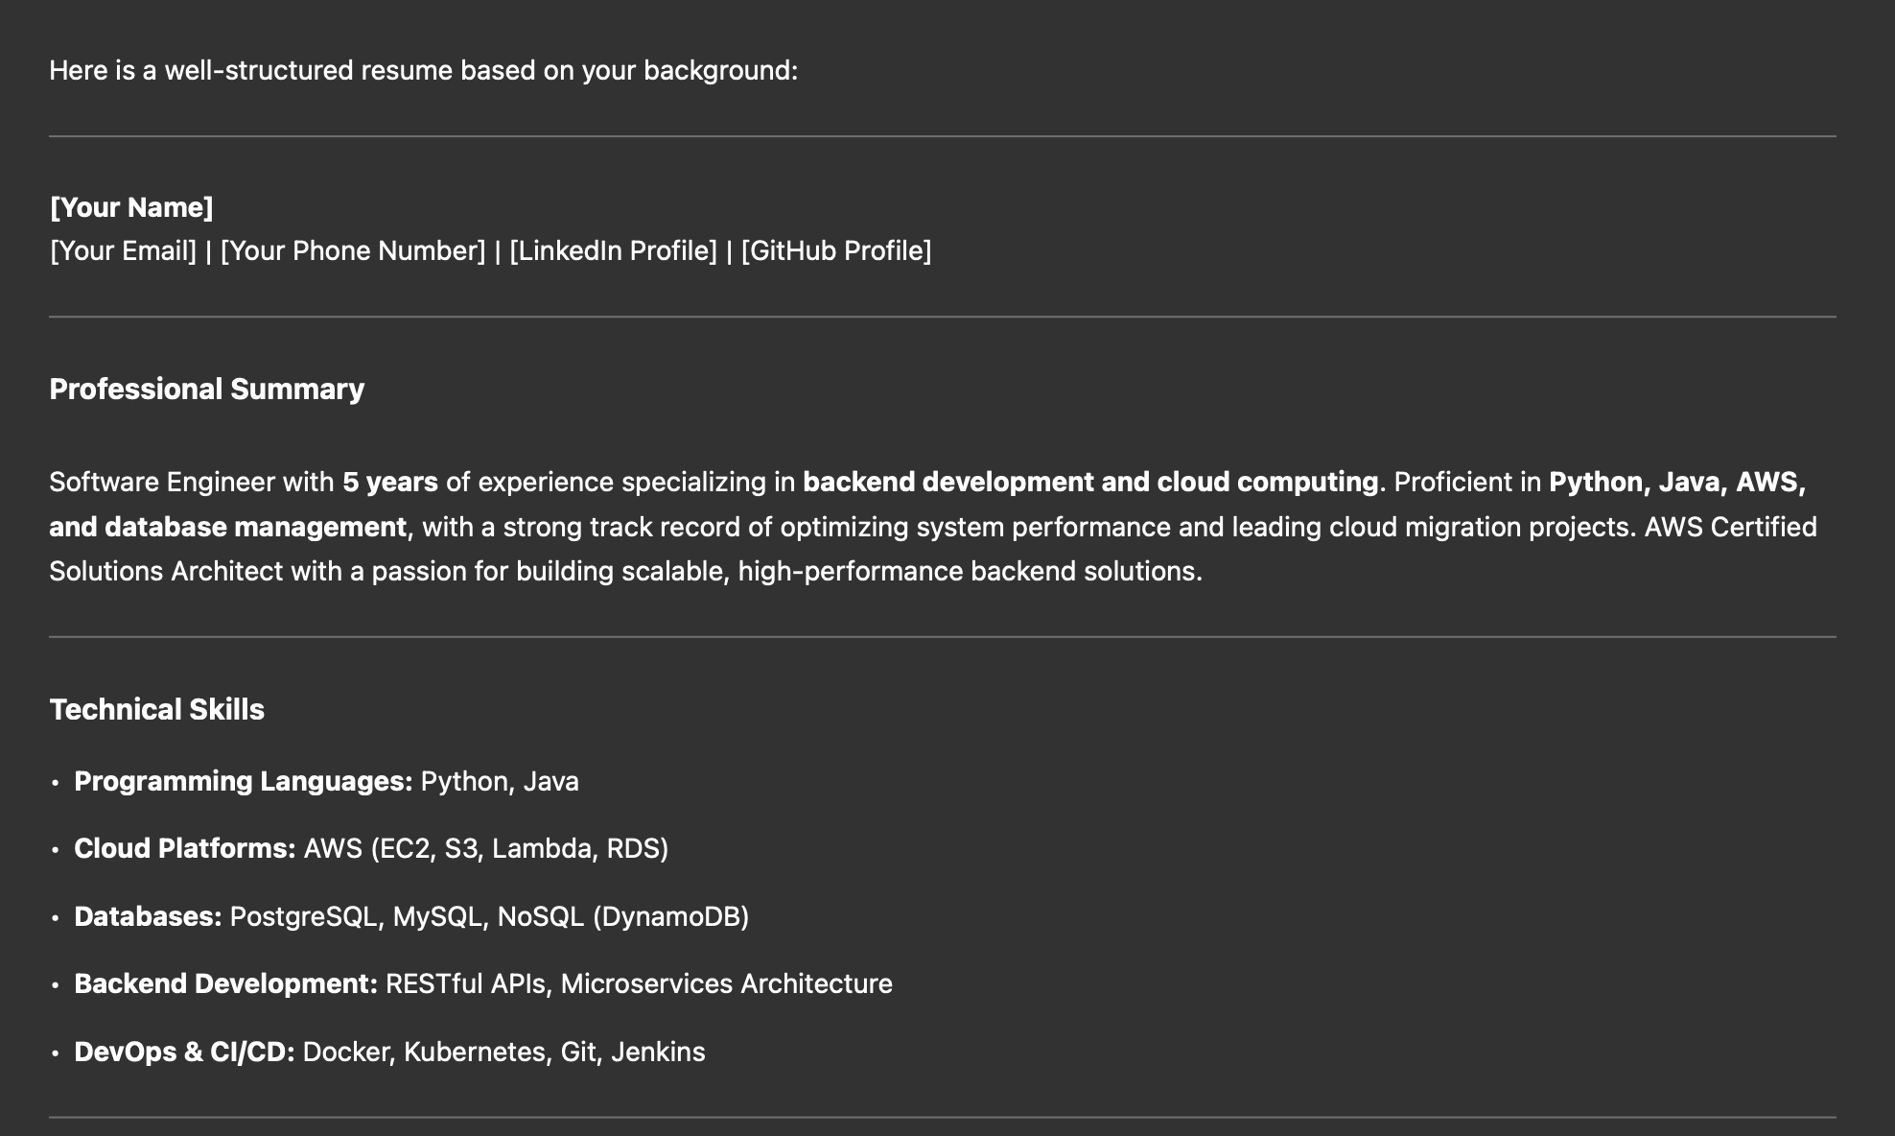
Prompt engineering
Instructions + Input
“Given the following information about my professional background, create a well-structured resume highlighting my skills and experience:
• Education: Bachelor’s degree in Computer Science from the University of Barcelona.
• Work experience: 5 years as a software engineer, specializing in backend development and cloud computing.
• Skills: Python, Java, AWS, and database management.
• Projects: Led the migration of a legacy system to a cloud-based architecture, improving performance by 40%.
• Certifications: AWS Certified Solutions Architect.”

Slide 12
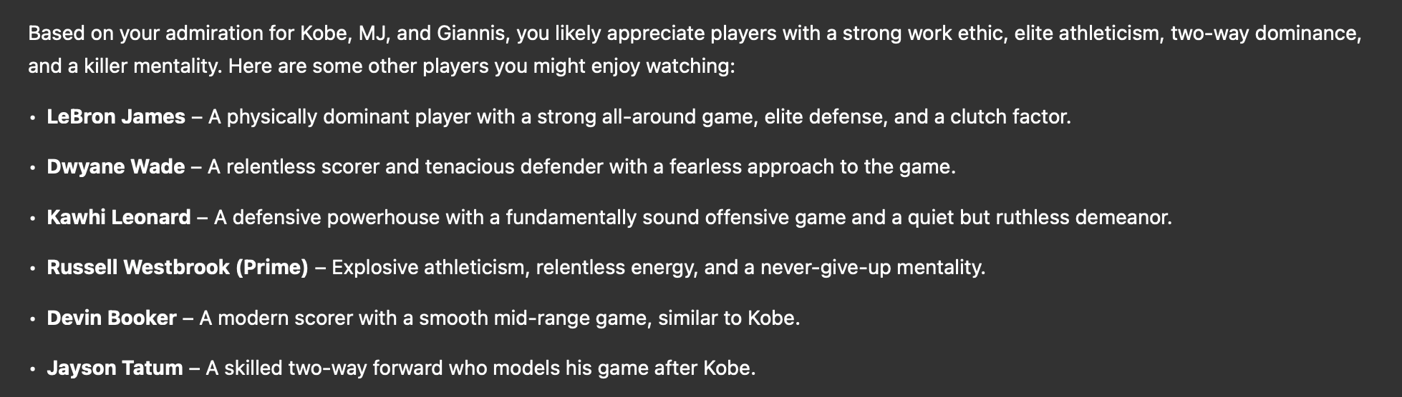
Prompt engineering
Question + Examples
“Here are some basketball players I really admire: Kobe Bryant, Michael Jordan, and Giannis Antetokounmpo. I’m not a big fan of James Harden’s playing style. Based on this, which other players do you think I might enjoy watching?”

Slide 13
Prompt engineering
Limitations of LLMs and plain prompts
• Lack of Memory: LLMs don’t retain past interactions, requiring external systems for context management.
• Variability in Responses: Due to their probabilistic nature, LLMs may generate different answers to the same prompt.
• Outdated Knowledge: LLMs rely on pre-trained data and lack real-time updates.
• Hallucination Risk: They can produce convincing but incorrect information.

Slide 14
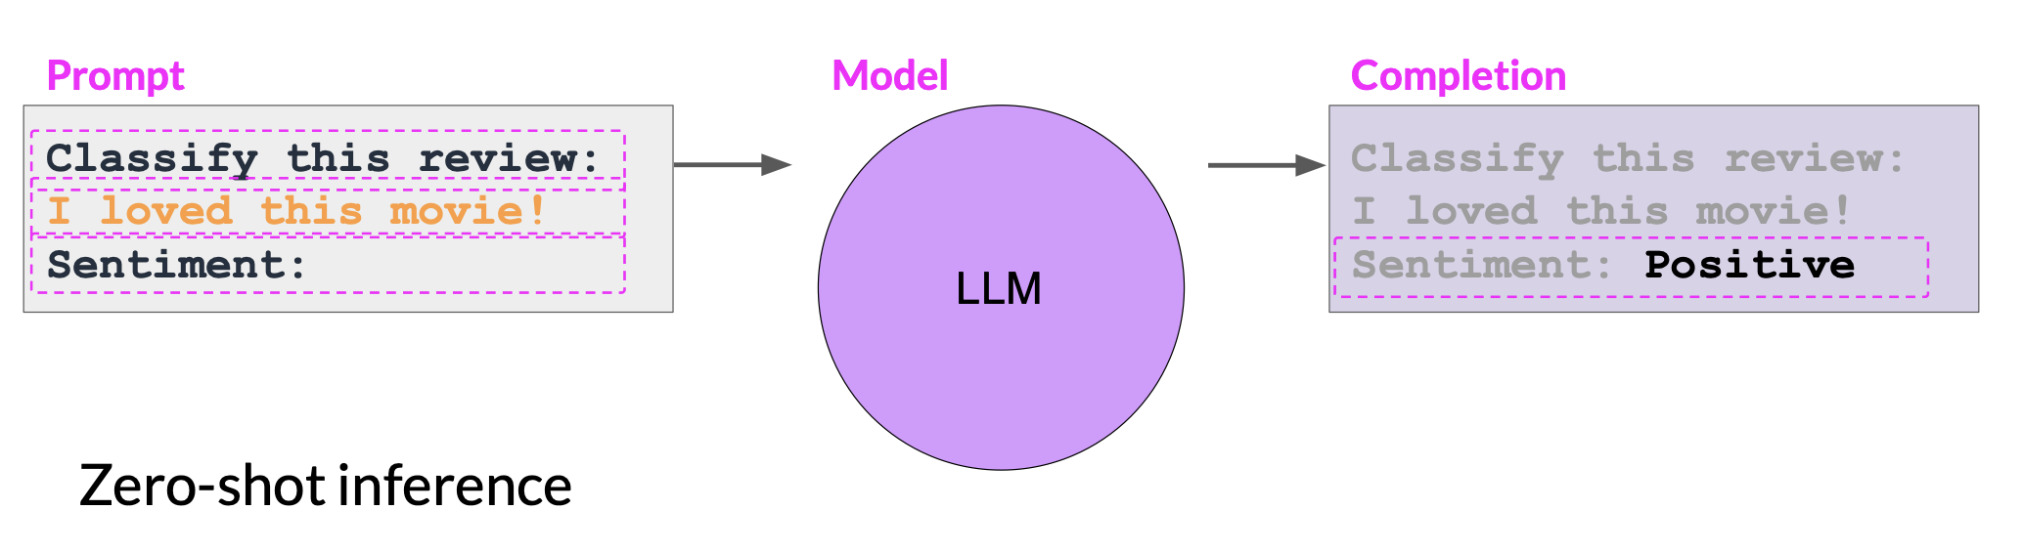
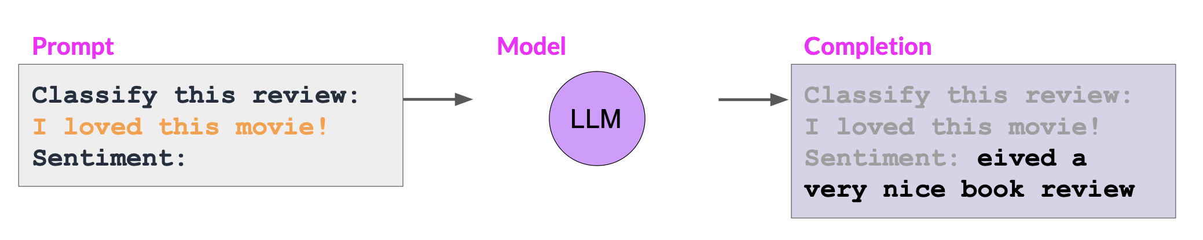
Prompt engineering
Few shots strategy

Slide 15
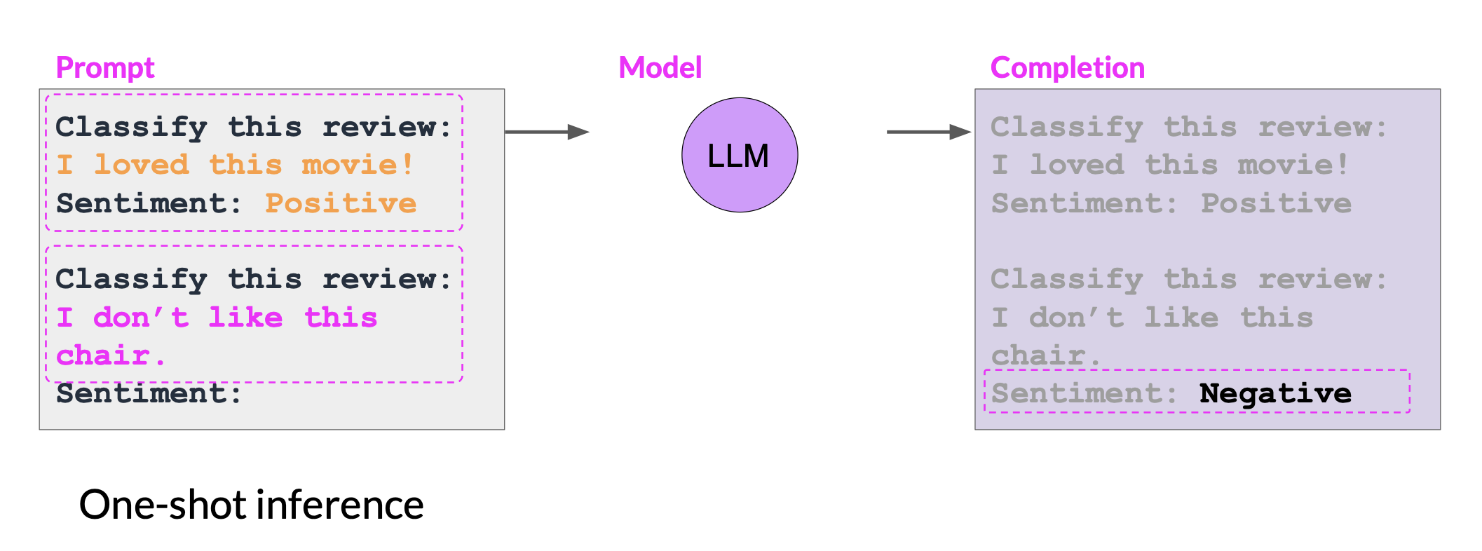
Prompt engineering
Few shots strategy

Slide 16
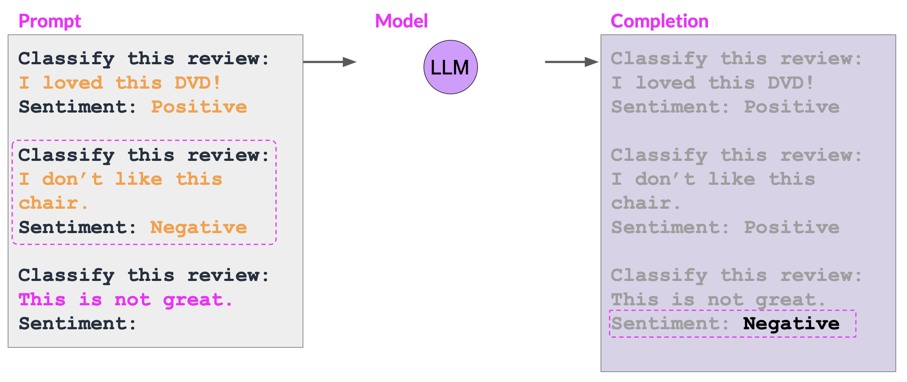
Prompt engineering
Few shots strategy

Slide 17
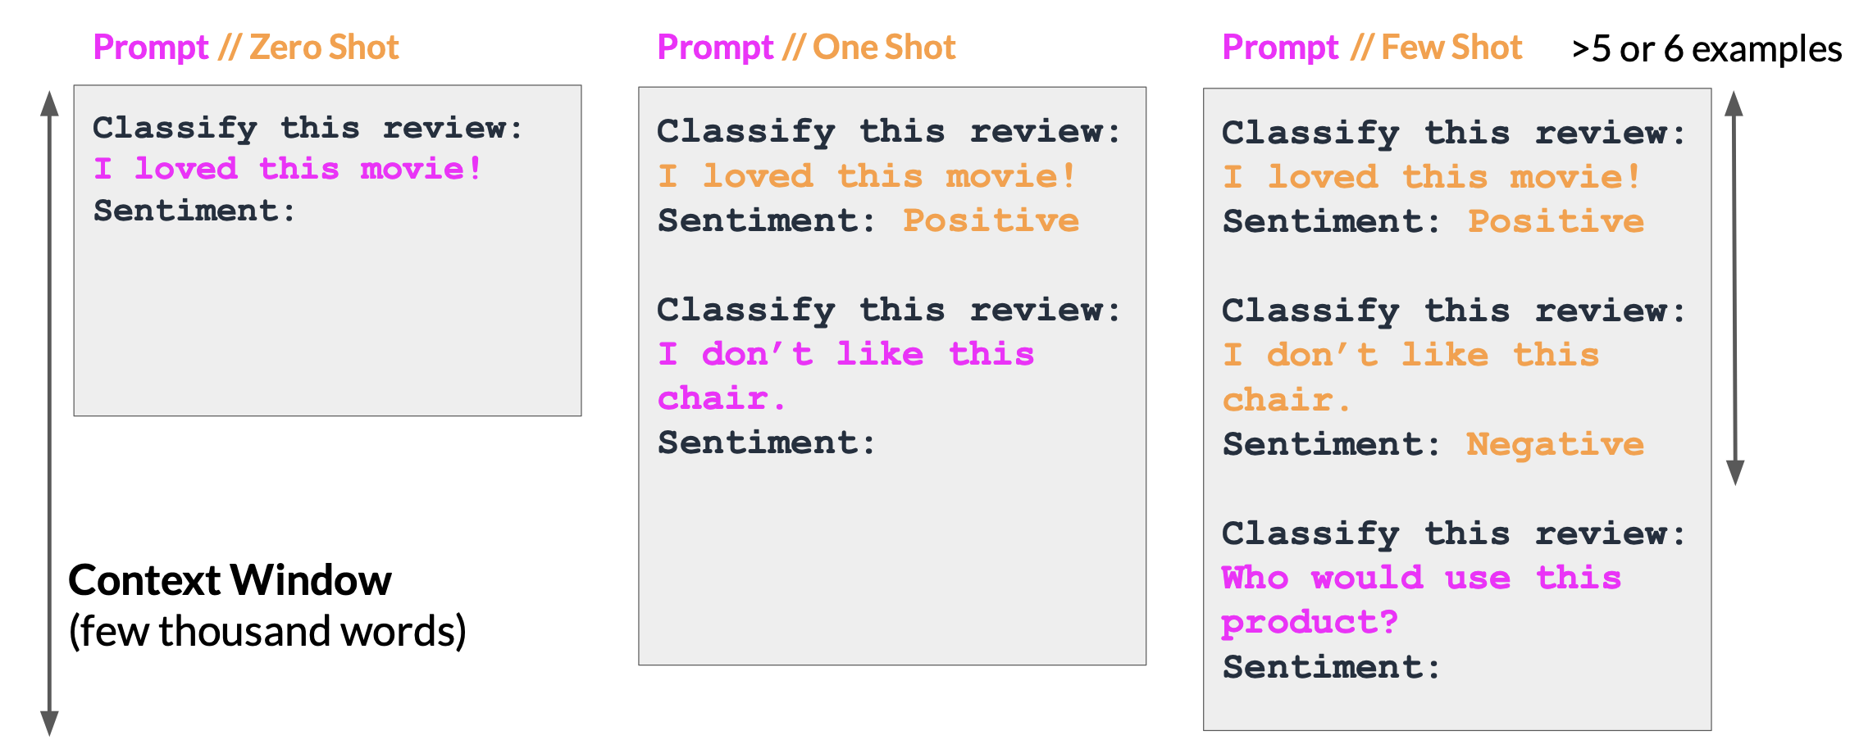
Prompt engineering
Few shots strategy

Slide 18
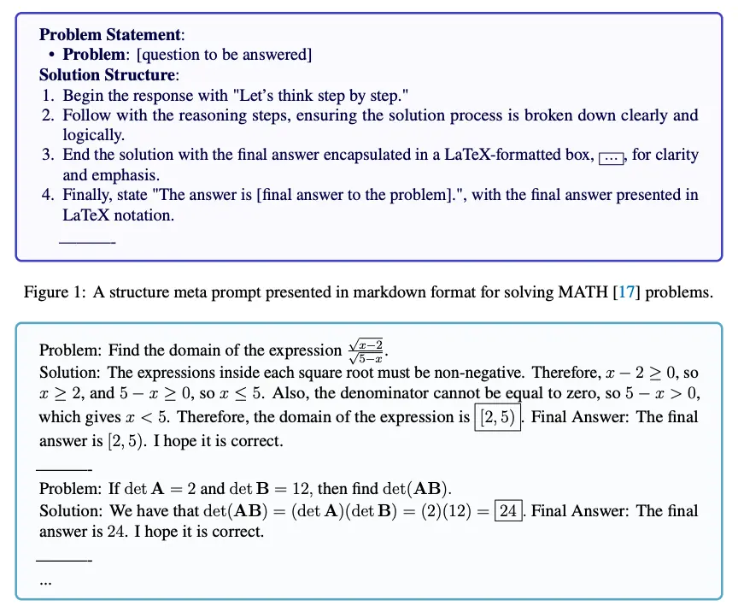
Prompt engineering
Meta prompting
1. Self-Prompting – The model is instructed to generate its own prompt before answering.
• Example: “Before solving, generate the best possible prompt to approach this problem.”
2. Prompt Optimization – The model refines or rephrases the initial prompt to improve clarity and accuracy.
3. Self-Reflection & Evaluation – The model evaluates its own response and iterates if needed.
• Example: “Did my answer fully address the question? If not, refine the prompt and try again.”

Slide 19
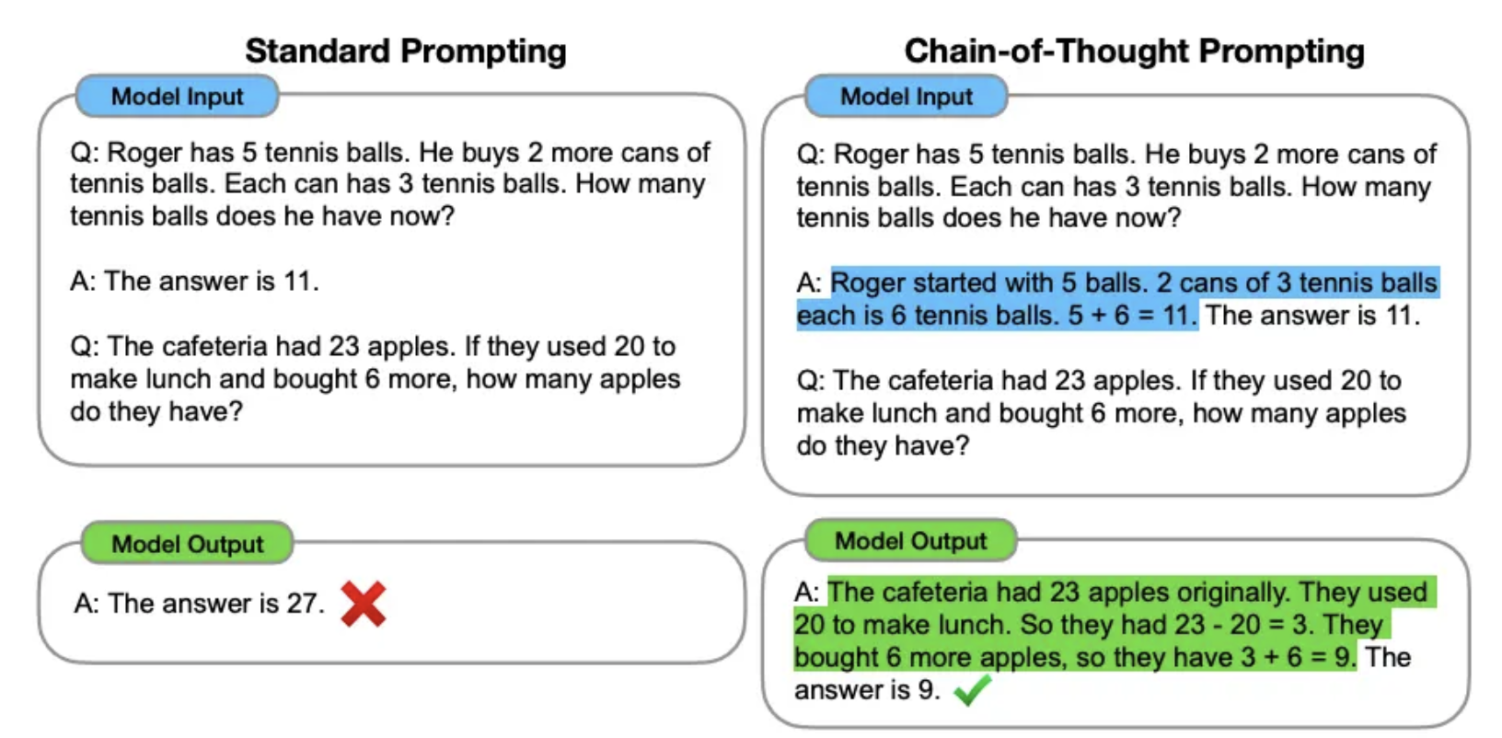
Prompt engineering
Chain of thought prompting
<original_question>?
Use this format:
Q: <repeat_question>
A: Lets think step by step. <give_reasoning>
Therefore, the answer is <final_answer>.

Slide 20
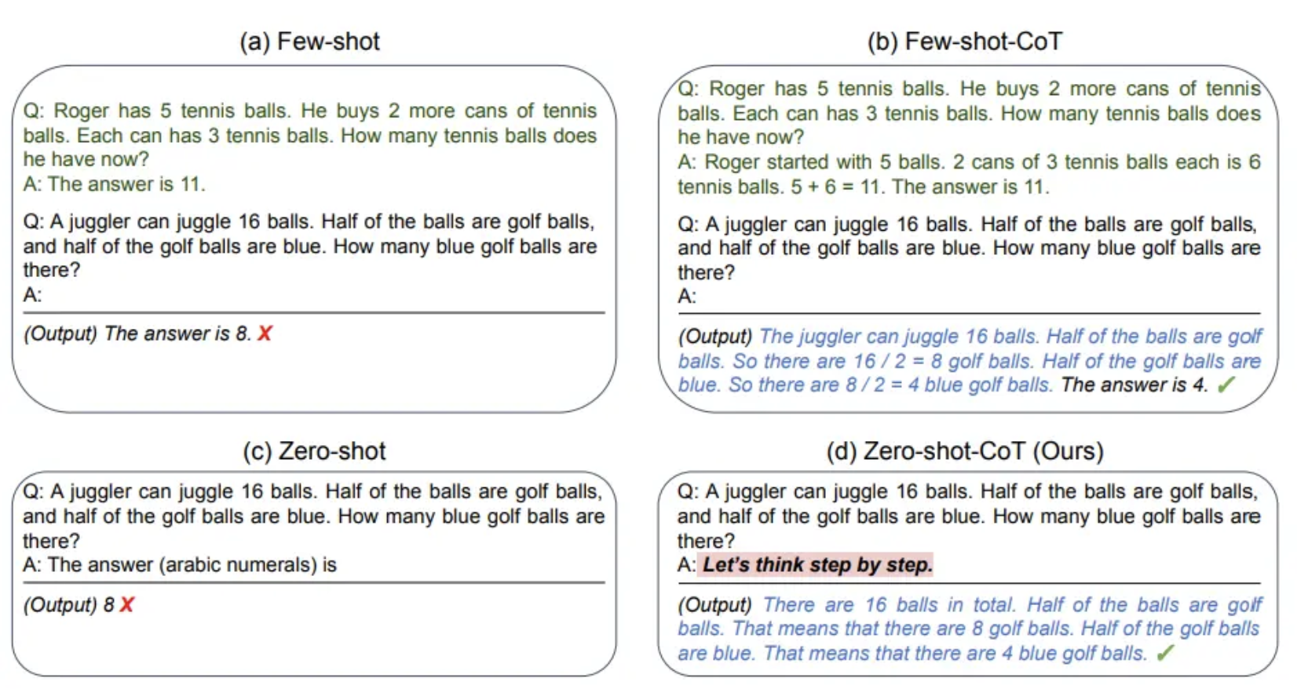
Prompt engineering
Zero-shot COT Prompting
”please”
(works with large models)

Slide 21
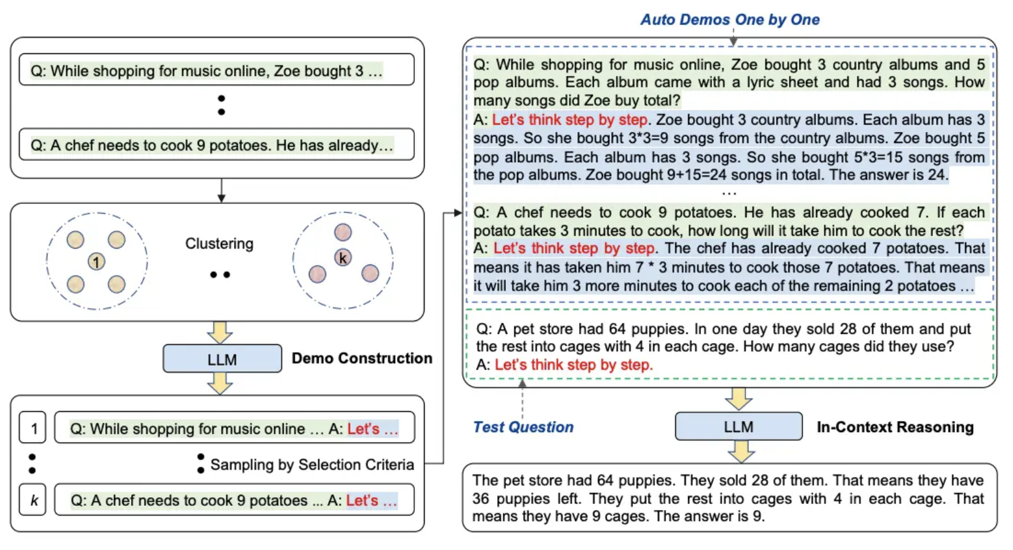
Prompt engineering
Automatic Chain-of-Thought (Auto-CoT)
Question Clustering – Group similar questions from the dataset into clusters.
2. Demonstration Sampling –
Select a representative question from each cluster and generate a reasoning chain using Zero-Shot-CoT with heuristics.

Slide 22
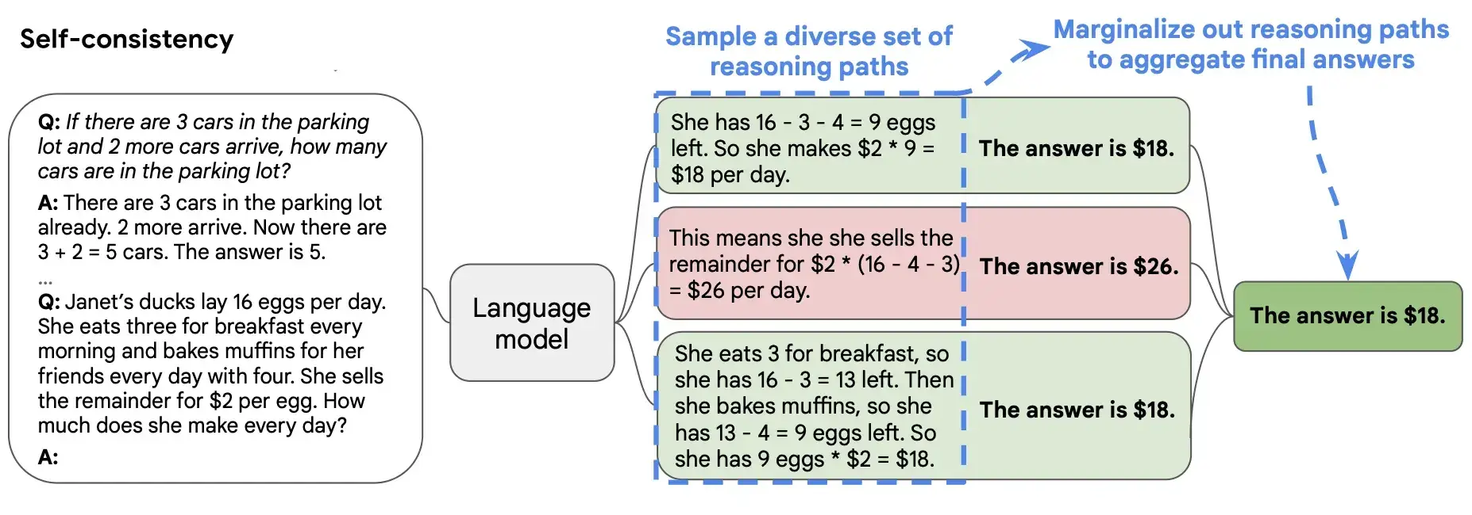
Prompt engineering
Self-Consistency

Slide 23
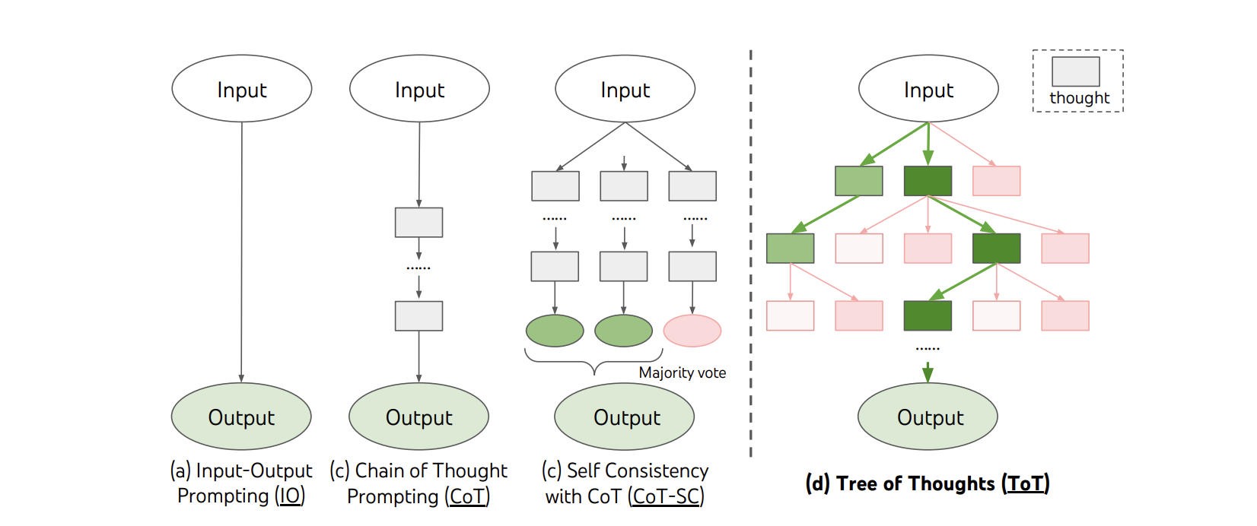
Prompt engineering
Tree of Thoughts (ToT)
Thought Nodes – Individual reasoning steps that branch out into multiple possibilities.
2. Branching Structure – Instead of one linear solution, ToT explores multiple thought paths.
3. Evaluation & Pruning – The AI evaluates different branches, discarding weaker paths to refine reasoning.
4. Recursive Exploration – AI can backtrack and reconsider previous decisions for better outcomes.

Slide 24
Resources
“Prompt Design and Engineering: Introduction and Advanced Methods”
https://arxiv.org/html/2401.14423v4
“Prompt engineering Guide”
https://www.promptingguide.ai
Github – Prompt engineering Guide
https://github.com/dair-ai/Prompt-Engineering-Guide?tab=readme-ov-file

